Slide 1
Method for Sedentary Position Detection
Kamrul H Foysal

Slide 2
Preprocessing:
Image Acquisition from the thermal video recording at 8fps
Image Resizing to 40% of the original image in size
Grey-scaling using rgb2grey
Edge Detection using SOBEL edge Detection Method

Slide 3
SURF Feature
Interest point detector finds distinctive locations in image (corners, blobs, T-junctions)
Interest point descriptor used for matching
should be distinctive and robust

Slide 4
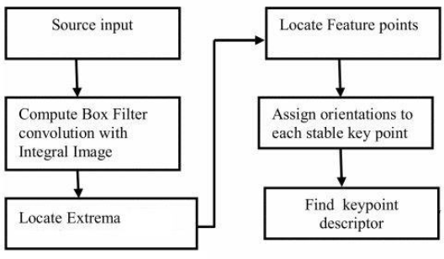
SURF: Flowchart

Slide 5
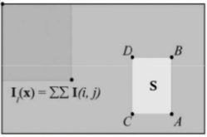
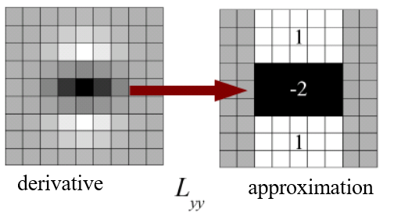
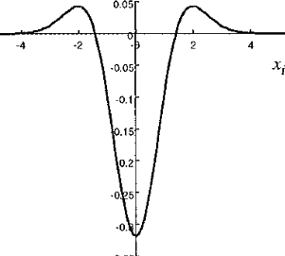
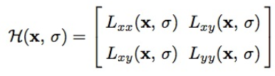
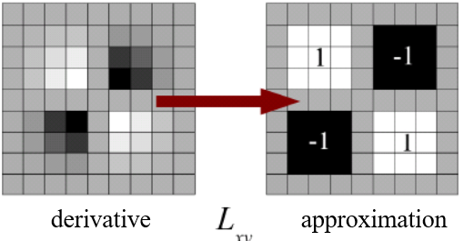
Feature Extraction: SURF
Integral of Image
Determinant of Hessian
Integral Image is formed
Pixel_sum =A+D-B-C
For Fast Calculation
Interest Point Localization
Laplacian of Gaussian Applied
Feature Points are Located
LoG Approximation Calculated

Slide 6
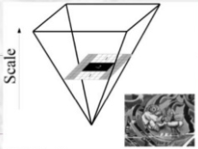
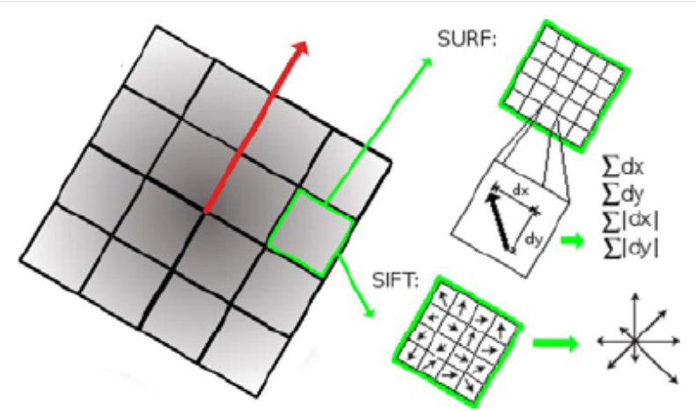
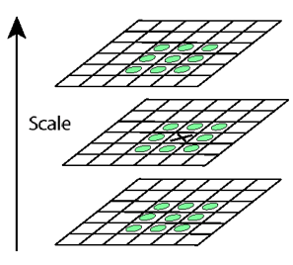
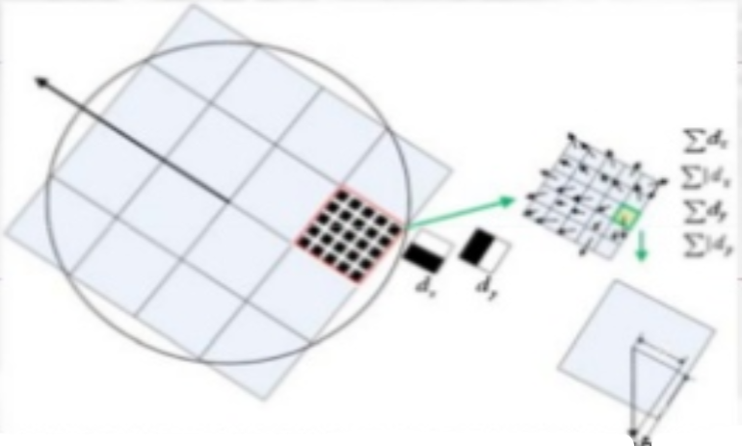
Feature Extraction: SURF
Scale Analysis
Non Maxima Suppression
Orientation Assignment
Change size of filters
Compare Intensity
among 26 neighbors

Slide 7
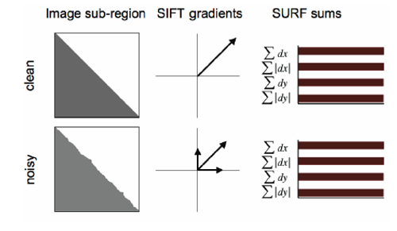

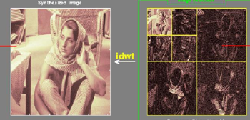
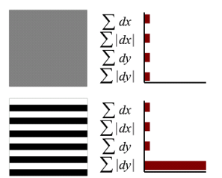
Descriptors
Keypoint Descriptor
Sign of the Laplacian
Haar Wavelet Filters
Distribution of the intensity content
within the interest point neighborhood
Compute Haar Wavelet Outputs
64-element descriptor
Geometric Invariant Representation

Slide 8
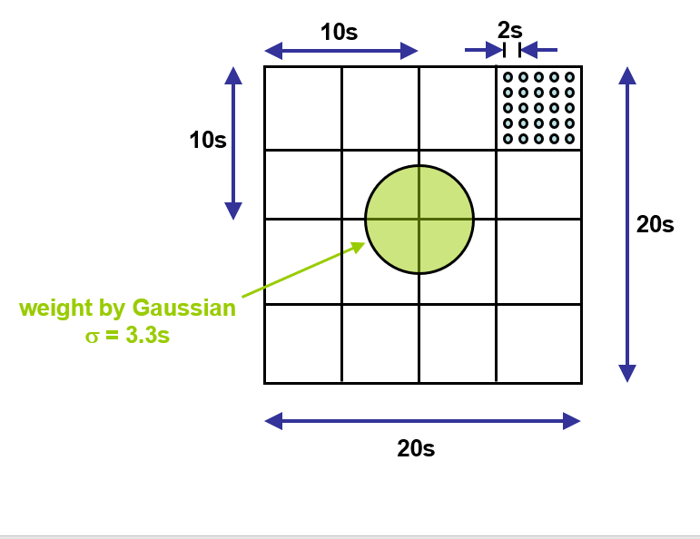
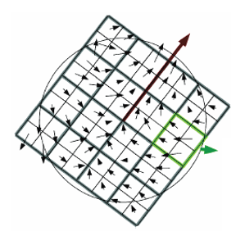
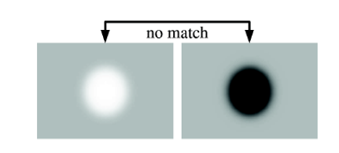
Matching
sign of LoG (Lxx+Lyy)
distance function that compares two descriptors
calculating the Euclidean distance between their descriptor vectors

Slide 9
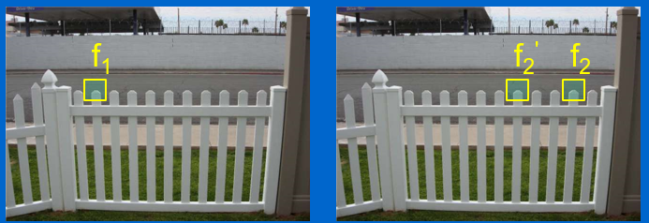
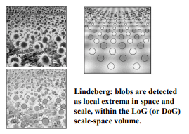
Matching
Descriptor Points
Distance of vector for matching pair
calculating the Euclidean distance between their descriptor vectors

